Slide 1


Scale-Invariant Feature Transform
Sift
第一組 黃少鏞
107.05.14

Slide 2

goal
Learn about the concepts of SIFT algorithm
Theory
Learn to find SIFT Keypoints and Descriptors
Scale-space Extrema Detection
Keypoint Localization
Orientation Assignment
Keypoint Descriptor
Keypoint Matching

Slide 3
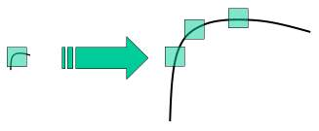
theory
In last couple of chapters, we saw some corner detectors like Harris etc. They are rotation-invariant, which means, even if the image is rotated, we can find the same corners. It is obvious because corners remain corners in rotated image also. But what about scaling? A corner may not be a corner if the image is scaled. For example, check a simple image below. A corner in a small image within a small window is flat when it is zoomed in the same window. So Harris corner is not scale invariant.

Slide 4
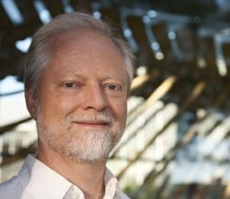
theory
So, in 2004, David G. Lowe, University of British Columbia, came up with a new algorithm, Scale Invariant Feature Transform (SIFT) in his paper, Distinctive Image Features from Scale-Invariant Keypoints, which extract keypoints and compute its descriptors.
There are mainly four steps involved in SIFT algorithm.

Slide 5
Scale-space Extrema Detection
From the image above, it is obvious that we can't use the same window to detect keypoints with different scale. It is OK with small corner. But to detect larger corners we need larger windows. For this, scale-space filtering is used. In it, Laplacian of Gaussian is found for the image with various σ values. LoG acts as a blob detector which detects blobs in various sizes due to change in σ. In short, σ acts as a scaling parameter. For eg, in the above image, gaussian kernel with low σ gives high value for small corner while guassian kernel with high σ fits well for larger corner. So, we can find the local maxima across the scale and space which gives us a list of (x,y,σ) values which means there is a potential keypoint at (x,y) at σ scale.

Slide 6
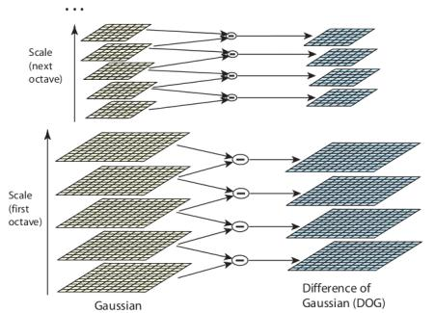
Scale-space Extrema Detection
But this LoG is a little costly, so SIFT algorithm uses Difference of Gaussians which is an approximation of LoG. Difference of Gaussian is obtained as the difference of Gaussian blurring of an image with two different σ, let it be σ and kσ. This process is done for different octaves of the image in Gaussian Pyramid.

Slide 7
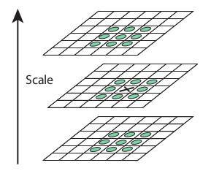
Scale-space Extrema Detection
Once this DoG are found, images are searched for local extrema over scale and space. For eg, one pixel in an image is compared with its 8 neighbours as well as 9 pixels in next scale and 9 pixels in previous scales. If it is a local extrema, it is a potential keypoint. It basically means that keypoint is best represented in that scale.
NEXT SCALE
DoG
PREVIOUS SCALES

Slide 8
Keypoint Localization
Once potential keypoints locations are found, they have to be refined to get more accurate results. They used Taylor series expansion of scale space to get more accurate location of extrema, and if the intensity at this extrema is less than a threshold value (0.03 as per the paper), it is rejected. This threshold is called contrastThreshold in OpenCV
DoG has higher response for edges, so edges also need to be removed. For this, a concept similar to Harris corner detector is used. They used a 2x2 Hessian matrix (H) to compute the pricipal curvature. We know from Harris corner detector that for edges, one eigen value is larger than the other. So here they used a simple function,
If this ratio is greater than a threshold, called edgeThreshold in OpenCV, that keypoint is discarded. It is given as 10 in paper.
So it eliminates any low-contrast keypoints and edge keypoints and what remains is strong interest points.

Slide 9
Orientation Assignment
Now an orientation is assigned to each keypoint to achieve invariance to image rotation. A neigbourhood is taken around the keypoint location depending on the scale, and the gradient magnitude and direction is calculated in that region. An orientation histogram with 36 bins covering 360 degrees is created. (It is weighted by gradient magnitude and gaussian-weighted circular window with σ equal to 1.5 times the scale of keypoint. The highest peak in the histogram is taken and any peak above 80% of it is also considered to calculate the orientation. It creates keypoints with same location and scale, but different directions. It contribute to stability of matching.

Slide 10
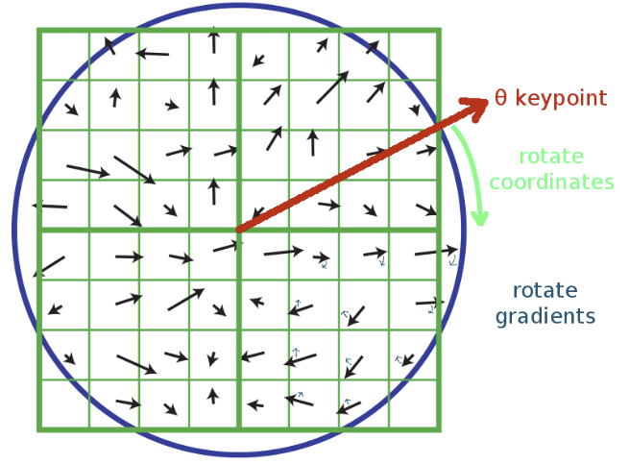
Keypoint Descriptor
Now keypoint descriptor is created. A 16x16 neighbourhood around the keypoint is taken. It is devided into 16 sub-blocks of 4x4 size. For each sub-block, 8 bin orientation histogram is created. So a total of 128 bin values are available. It is represented as a vector to form keypoint descriptor. In addition to this, several measures are taken to achieve robustness against illumination changes, rotation etc.

Slide 11
Keypoint Matching
Keypoints between two images are matched by identifying their nearest neighbours. But in some cases, the second closest-match may be very near to the first. It may happen due to noise or some other reasons. In that case, ratio of closest-distance to second-closest distance is taken. If it is greater than 0.8, they are rejected. It eliminates around 90% of false matches while discards only 5% correct matches, as per the paper.

